Slide 1
Mr Tharme, Principal
Mrs Warr, Head of Secondary
Mrs Taylor, Head of EYFS & KS1
Mrs Burder, Assistant Principal
Mr Tewkesbury, Assistant Principal

Slide 2
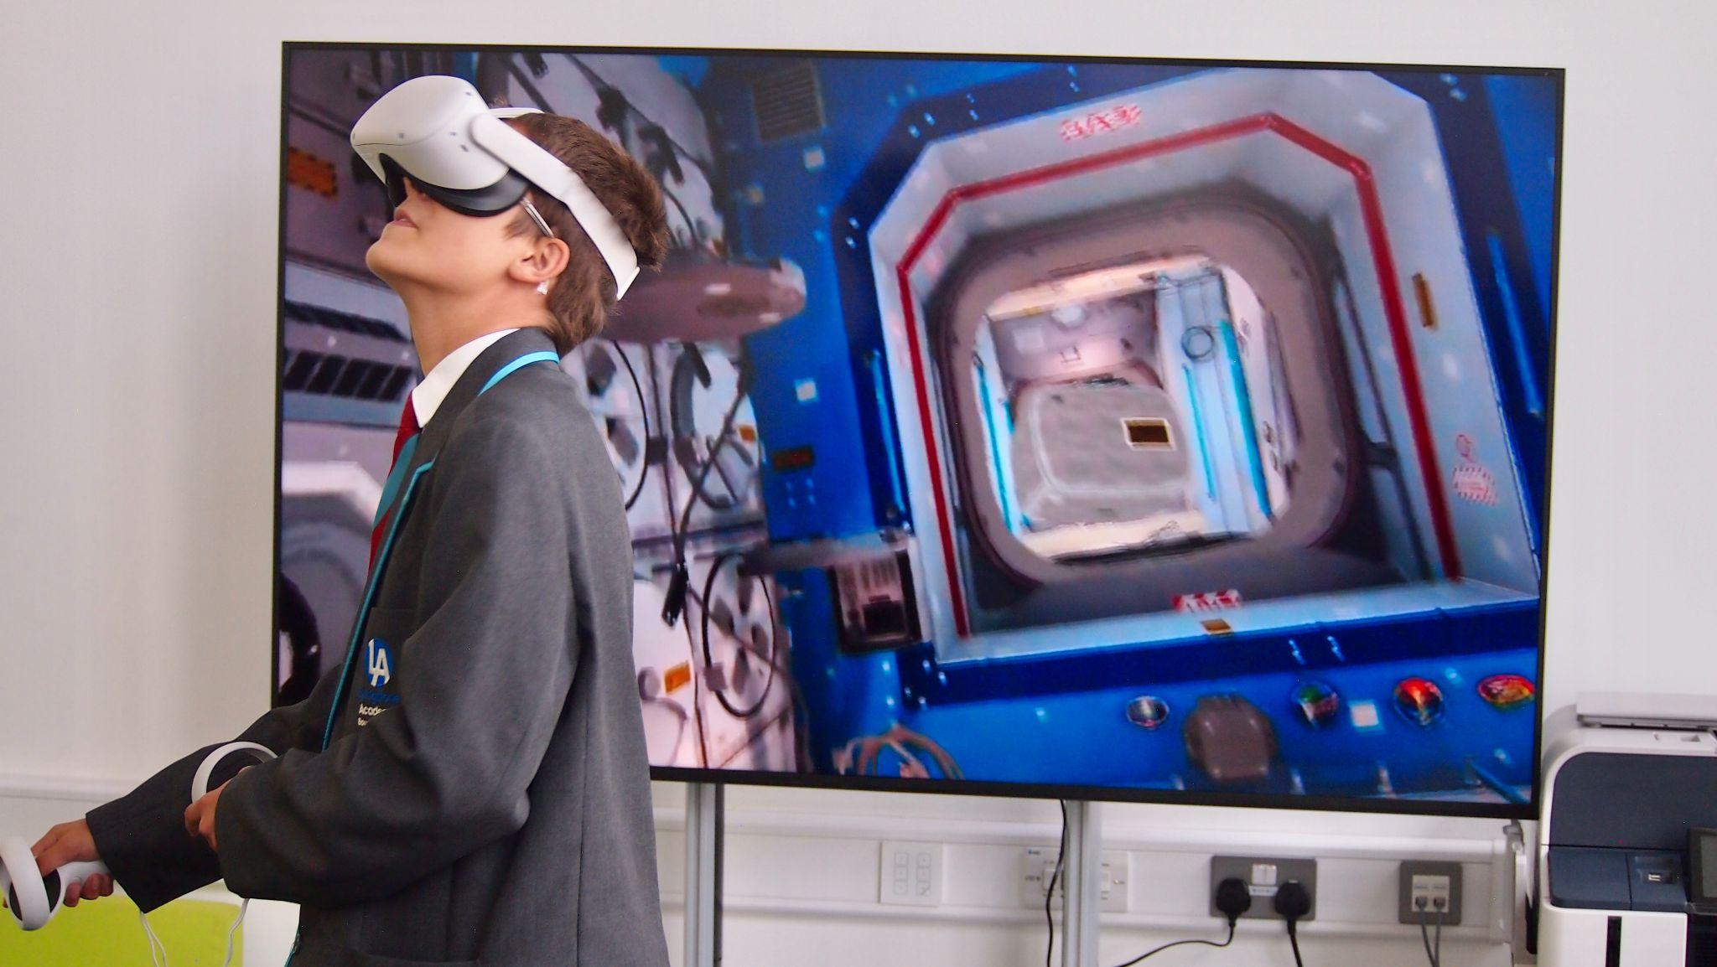
Our aim is for Livingstone Academy Bournemouth (LAB) to be the epitome of the Aspirations Framework:
An authentic education through applied learning
Applied transdisciplinary learning across the curriculum
Improved transition into Year 7
Power skills development
Unique in ensuring digital creativity
High levels of success for all - students will have the qualifications, knowledge and skills required to thrive in an ever-changing world.
Notes:
NUL

Slide 3
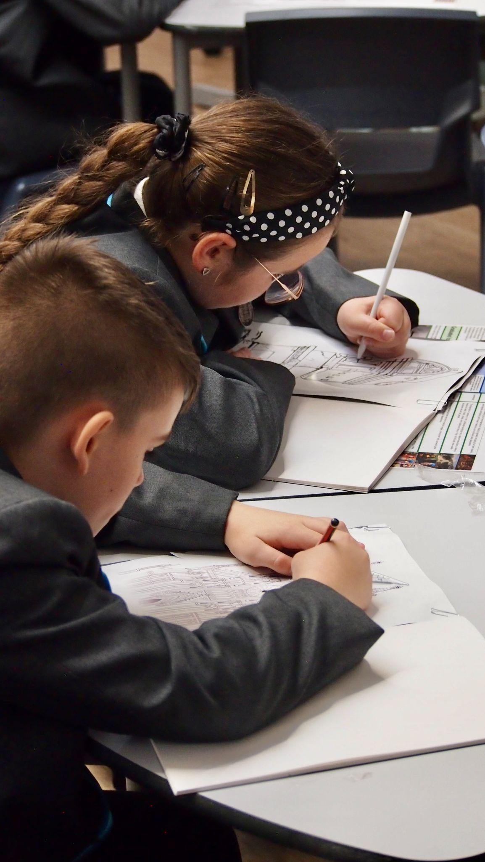
Our Curriculum Principles
Grounded in knowledge - knowing more and remembering more. Each individual subject must be valued in it’s own right.
The application of knowledge - Applying what they know in challenging, authentic and engaging ways within and across the curriculum.
Pupils developing POWER skills through regular applied learning: Communication, Collaboration, Creativity, Critical thinking & Problem Solving.
Developing digital creators, rather than digital consumers.
Notes:
LTH

Slide 4
A Year 7&8 model that creates…
A smoother transition and greater sense of belonging:
A gradual change for children from the primary model
One teacher for 70% of the week who really gets to know the children
An improved continuity of learning from KS2:
A similar approach and model to KS2
An opportunity to implement ATL effectively:
Enabling collaborative planning and flexible timetabling
With fewer subject teachers, implementing ATL across the curriculum poses less of a challenge
Collaboration and diversity for teachers:
Timetabled planning time every week and delivering multiple subjects across the curriculum - this is an exciting prospect for many teachers.
Notes:
LTH

Slide 5
Creator Space: STEAM powered education
As part of their timetable, each teacher will have a timetabled double period with half of their class (opposite to DT in the timetable) every other week to complete a Creator Space project. A total of 3 double sessions per half term. These are designed to match the Power skill focus for the term and will include opportunities for students to complete projects involving: Digital creativity Micro:bits and coding software Augmented reality Virtual reality Gaming and apps creation Lego/K’nex education, Minecraft education, E-Sports Computer-aided design and 3D printing Laser printing
Notes:
LTH

Slide 6
Parental engagement and communication
Email comms

Slide 7
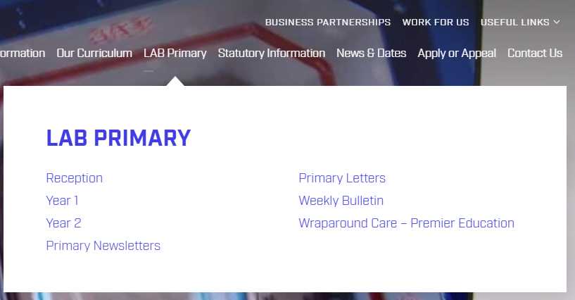
Parental engagement and communication

Slide 8
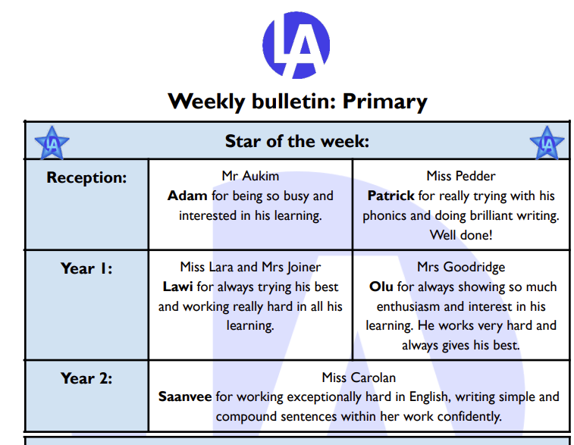
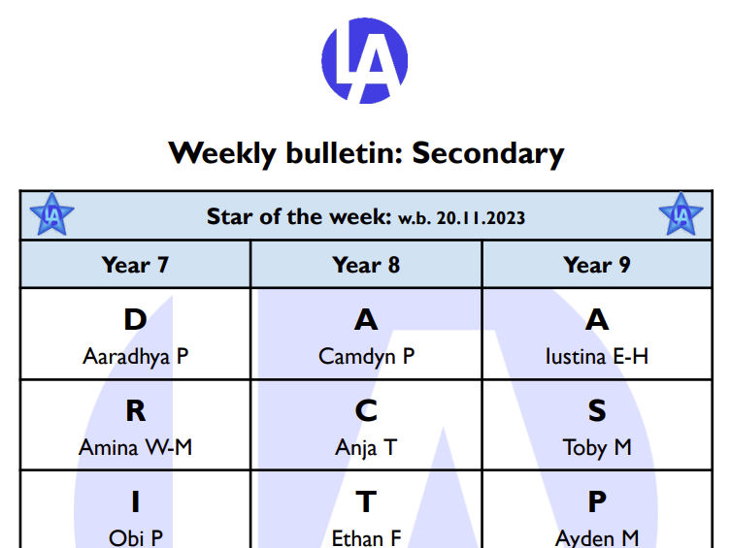
Parental engagement and communication

Slide 9
Home Learning Rationale
Well organised home learning can play a vital role in raising standards of achievement.
Home learning has the potential to make an important contribution to classroom accelerated learning and the purpose of homework should be to practice, reinforce, embed or apply acquired skills and knowledge. All research suggests that home learning enhances pupil learning, improves achievement and develops pupils’ independent study skills that generates an ethic of lifelong learning habits.
In a recent study by the Educational Endowment Fund, “homework has a positive impact on average (+ 5 months), particularly with pupils in secondary schools” (2021).

Slide 10
Meaningful and Accessible
LAB believes in raising the profile of learning by providing carefully selected platforms for the core areas of curriculum. These platforms enable learners to practice retrieving knowledge they have already been taught in order to embed it in their long term memory.
The platforms are intuitive to each child and enable learners to practice the knowledge and skills which will benefit them most. Furthermore, they have methods for children and parents to reflect on their skills gap.
The platforms are easily accessible for children and can be used on a range of devices.
We recognise that parents and carers make a real difference to children’s education and, when parents and carers work in partnership with school, our young people achieve better outcomes. By demonstrating an interest and discussing home learning with your child, you will enable our young people to recognise that the home school relationship is supporting them on a lifelong journey to learn and it’s essential our young people recognise the value of it.

Slide 11
Intentions…
KS1:
20 mins per day minimum expectation
10 mins Daily reading - Little Wandle reading record with decodable book
Use of the below platforms - 10 mins:
TT Rockstars x 1 per week
Numbots x 2 per week
Lexia x 2 per week
Flash Academy*
KS3:
30-40 mins per day minimum expectation:
Sparx maths
Sparx reader
Tassomai English
Tassomai Science

Slide 12
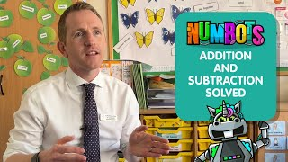
KS1

Slide 13
KS1 Support
All platforms are paid for by the academy - access for all.
All platforms send out parent emails so that you can keep track of the home learning and support your child.
Teachers will check once per week and there will be linked achievement points.
In early Spring term, we will be holding a ‘how to read with your child’ and ‘effective home learning’ workshop with the intention of all parents attending to outline our home learning plans.
This will be at 3:00pm to tie in with regular collection times to engage and include as many parents as possible.
Teaching and support staff will supervise all children in the hall until 3:30pm so that all parents can attend.
The meeting will be repeated at 5:30pm for any parents unable to attend or whose children attend wrap around care.

Slide 14
Suggested Home Learning Timetable: KS3
Below is a suggestion for a child’s home learning throughout the week:
Day | Subject | Platform | Time Spent
Monday | English Science | Tassomai Tassomai | 20 minutes 20 minutes
Tuesday | Reading Maths | Sparx Reader Sparx Maths | 10 minutes 20 minutes
Wednesday | English Science | Tassomai Tassomai | 20 minutes 20 minutes
Thursday | Reading Maths | Sparx Reader Sparx Maths | 10 minutes 20 minutes
Friday | English Science | Tassomai Tassomai | 20 minutes 20 minutes
Weekend | Reading Maths | Sparx Reader Sparx Maths | 10 minutes 20 minutes
Each day, it is suggested children are doing no more than 40 minutes.
This allows them to balance home learning with hobbies and their rest.

Slide 15
Sparx
You may already be familiar with Sparx Maths and more recently Sparx Reader. These have already been hugely successful with supporting our children with their independent reading and practice.
Sparx Reader enables all children to access to online books. It aims to improve the reading habits of children by encouraging slow and careful reading.
Sparx Maths personalises each child’s home learning, creating a weekly set of questions tailored to their level of understanding and learning pace. Each week, topics are set by your child’s maths teacher and will make up the majority of the home learning questions. Questions from previous topics will also be included in the home learning so that pupils can keep practising the skills they have learned.

Slide 16
Tassomai
From January, we will be launching Tassomai for English and Science practice. Your child will be onboarding with their teachers over the next two weeks to ensure they are familiar with the platform.
Tassomai helps children learn and revise more effectively. The program combines multiple- choice quizzes, short tutorial videos and links to external learning resources all tailored to your child’s individual learning needs.
On Tassomai, pupils are set Daily Goals. Daily Goals asks the child to answer a certain number of questions correctly each day. Children should aim to complete four Daily Goals each week. This method allows for children to follow a little but often approach which is considered best for our memory. Alternatively, children can complete their home learning through completing their weekly goals which offers more flexibility and allows them to gain their points at any point through the week (e.g. they could do it all in one go)

Slide 17
KS3 Support
All platforms are paid for by the academy - access for all.
All platforms send out parent emails so that you can keep track of the home learning and support your child.
Home learning Club is currently on once a week.
Advisors and class teachers will regularly check the hand in progress to prompt the children who still need to complete.
Home learning detention- for each piece of home learning a child does not complete, they will receive a home learning behaviour point. If a child gains three home learning behaviour points this will trigger a one hour detention on Friday from 3-4pm.
Monitoring engagement and offering achievement points and rewards.

Slide 18
Thank you and questions
Thank you for your attendance and helpful suggestions.
Please feel free to catch us individually, if you have any questions or suggestions.
The next Parent Forum will be held during the Spring term.
We will send an invite to all parents.

