Slide 1
My Learning,
My Future
Where can studying Music take you?
Highlighting the relevance of Music
to future careers and opportunities
Notes:
Purpose of slides:
To allow you to highlight the relevance of your subject to future careers and opportunities
Aims:
To engage students in your subject
To highlight pathways and opportunities from your subject
To encourage students to consider your subject at KS4/Post 16
To support work across the school towards Gatsby Benchmark 4
How to use these slides?
These slides can be used at any point during KS3/4 to engage students in learning and to highlight the relevance of your subject to future careers and opportunities
They will be of most relevance within an option process and can support work you are doing to encourage students to consider their options for KS4/Post 16

Slide 2

What careers can you think of that use Music?
Why Music matters
What do you think these roles involve (daily task, etc.)?
Have you ever considered where studying Music can take you?
Today, we’ll be exploring some of
the career opportunities that are available to you, as well as the various pathways you can take to get there.
What skills do you think you might need for these roles?

Slide 3
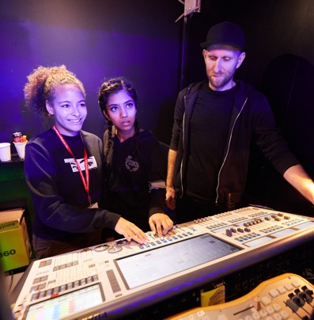


Music Teacher
Explore a career as a…
iCould Case Study
Here are some example roles and careers linked to Music
Songwriter/Musician
BBC Bitesize Video
Notes:
Jobs that use Music BBC Bitesize Careers: https://www.bbc.co.uk/bitesize/tags/zdg8f4j/jobs-that-use-music/1
Activity Ideas:
Ahead of revealing content of slide, encourage students to think about as many roles linked to your subject as they can in pairs/groups
Encourage students to engage with specific videos/profiles or direct students to specific roles/careers to predict, research and reflect on:
Pathways
Essential Skills
Wages/Work Conditions
Why they might like/not like that role?

Slide 4



Sound Engineer
Explore a career as a…
BBC Bitesize Video
Music Director
BBC Bitesize Video
Here are some example roles and careers linked to Music
Musical instrument maker and repairer
iCould Case Study
Notes:
Jobs that use Music BBC Bitesize Careers: https://www.bbc.co.uk/bitesize/tags/zdg8f4j/jobs-that-use-music/1
Activity Ideas:
Ahead of revealing content of slide, encourage students to think about as many roles linked to your subject as they can in pairs/groups
Encourage students to engage with specific videos/profiles or direct students to specific roles/careers to predict, research and reflect on:
Pathways
Essential Skills
Wages/Work Conditions
Why they might like/not like that role?

Slide 5
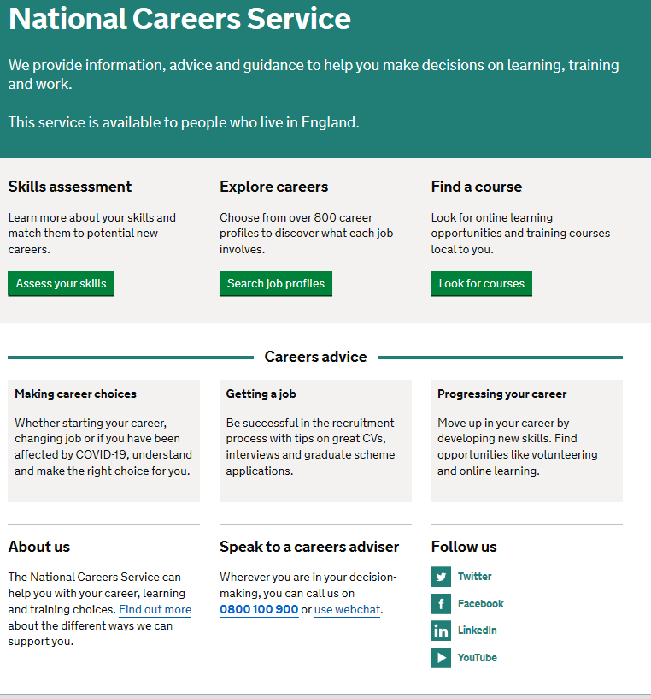

Discover more about the role
Explore careers using National Careers Service and find out about what jobs involve and how they are right for you
Includes:
Average Salary
Typical Hours
Work patterns
Pathways/How to Become
Essential Skills
Daily Tasks
Research Ideas:
Music Teacher
Songwriter/Musician
Sound Engineer
Musical Instrument Maker & Repairer
Notes:
How to use this slide:
Highlight the National Careers Service: Explore Careers Tool https://nationalcareers.service.gov.uk/explore-careers
Encourage students to access the tool and research general or specific roles linked to your subject
Set students comparative/reflective tasks about why students may/may not like jobs they research
Ask if your students have done the Buzz quiz (5mins to complete) – if they haven’t then consider setting this as a pre/post task to allow them to reflect on how these roles may suit them based n their profile. Take the test and find out which animal you are, too!
https://icould.com/buzz-embed/

Slide 6



Where can Music take you
Pathways at 16
Example Post 16 Routes
BTEC Music/Music Performance/Music Technology
Level 2/3 Music Performance/Music Technology/Music Production/Vocal Artist
Apprenticeship Ideas
Arts Therapist
Live Event Rigger
Event Assistant
Creative Venue Technician
Notes:
How to use this slide:
Encourage students to reflect on their thoughts and plans Post 16 and why they are the right route for them
Download the Where Can English Take You (Apprenticeship Poster) for display https://amazingapprenticeships.com/app/uploads/2020/01/Subject-poster_Drama-Music.pdf
For more information on T-Levels visit https://www.tlevels.gov.uk/

Slide 7
Where can Music take you
Pathways at 18
Example Degrees:
Music Performance
Music Theatre
Music Production
Music Journalism
Music Business
Music Management
Apprenticeship Ideas
Arts Therapist
Live Event Rigger
Event Assistant
Creative Venue Technician
Read more>
Notes:
How to use this slide:
Encourage students to predict and research potential degree subjects linked to your subject
Discuss any degree opportunities that surprised them or appealed to them
Encourage students to reflect on the right Post 18 route for them
Download the Where Can History Take You (Apprenticeship Poster ) for display https://amazingapprenticeships.com/app/uploads/2020/01/Subject-poster_Drama-Music.pdf

Slide 8




Essential Skills
 | Video | Skills Builder Resource KS3 | Skills Builder Resource KS4
The oral transmission of information or ideas | Watch here | Short Lesson Speaking Step 6-8 | Short Lesson Speaking Step 8-10
Working cooperatively with others towards achieving a shared goal | Watch here | Short Lesson Team Work Step 6-8 | Short Lesson Team Work Step 8-10
The ability to set clear, tangible goals and devise a robust route to achieving them | Watch here | Short Lesson Aiming High Step 6-8 | Short Lesson Aiming High Step 8-10
Here are three key skills needed for a career that uses Music.
Notes:
Essential Skills Developed in your subject
A critical part of effective careers provision is building students’ essential skills. These are the skills that underpin success in the classroom and the world of work: skills like Teamwork, Problem Solving, Speaking and Listening. Students need to be able to recognise their skillset and talk about it confidently too. They will probably be using them already in your lessons but this can be a confusing space, with lots of overlapping terminology.
The Skills Builder Universal Framework has been developed by CEC, Skills Builder Partnership, Gatsby Foundation and others to address this problem. The Framework breaks down eight essential skills into 16 teachable steps. It outlines a roadmap for progress, giving educators and employers a common language for talking about the skills that are essential for employment. You can explore the Interactive Framework here.
How to use this slide:
Follow these links for quick 2min videos “What is this skill?”
Listening
https://hub.skillsbuilder.org/resources/listening-overview/
Speaking
https://hub.skillsbuilder.org/resources/speaking-overview/
Problem Solving
https://hub.skillsbuilder.org/resources/problem-solving-overview/
Creativity
https://hub.skillsbuilder.org/resources/creativity-overview/
Staying Positive
https://hub.skillsbuilder.org/resources/staying-positive-overview/
Aiming High
https://hub.skillsbuilder.org/resources/aiming-high-overview/
Teamwork
https://hub.skillsbuilder.org/resources/teamwork-overview/
Leadership
https://hub.skillsbuilder.org/resources/leadership-overview/
Use the highlighted short lessons as starters/extension/homework tasks
There’s over 300 Short Lessons and a suite of other resources too. We have highlighted 3 essential skills that are likely to come up in your lessons. These Short Lessons are perfect for pastoral time and starters/plenaries. You can register here to access these resources: https://hub.skillsbuilder.org/account/login/
Encourage students to measure their own skills via the Skills Builder Skills Benchmark Tool: https://www.skillsbuilder.org/benchmark

Slide 9
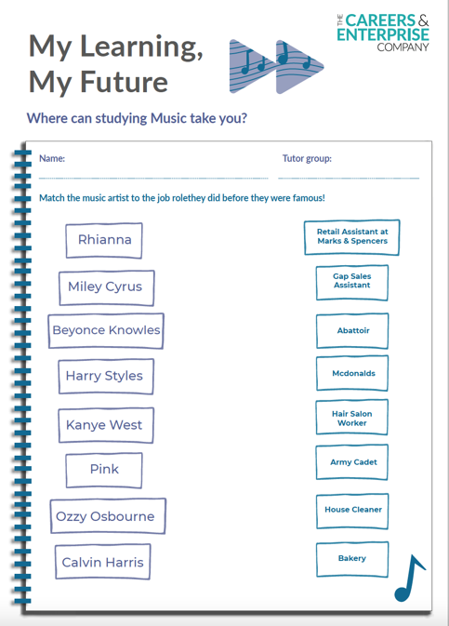
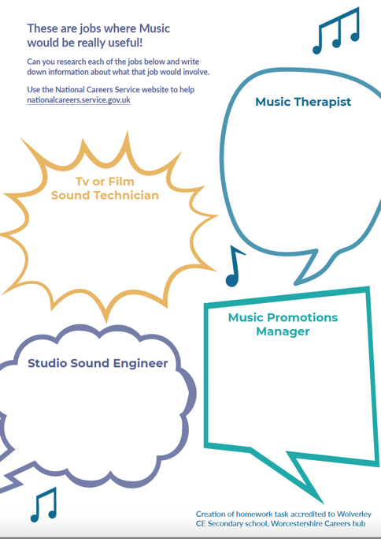
Music Homework Task
Understand where Music can take you by completing this exercise.
Download here
Notes:
How to use this slide
This resource can be set as a KS3 H/W task to encourage students to understand where your subject can take them and to engage in a research task about those roles using National Career Service https://nationalcareers.service.gov.uk/explore-careers
Ideas:
Use this research task as a basis for a presentation/discussion task in class
Consider parental engagement and how students can reflect on their learning on the relevance of your subject with parents/trusted adults

Slide 10
My Learning,
My Future

